Slide 1

Graph-Based Recommendations
Dr Seungmin Jin sedzhin@hse.ru
HSE

Slide 2
Course Objectives
Understand graphs, random walks, and PageRank.
Personalize recommendations using restart distributions.
Build a PPR recommender
Compare PPR with MF and discuss their business value.

Slide 3
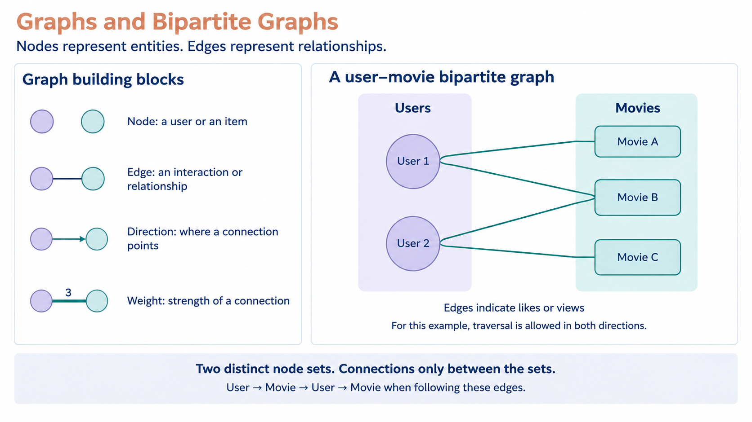

Slide 4
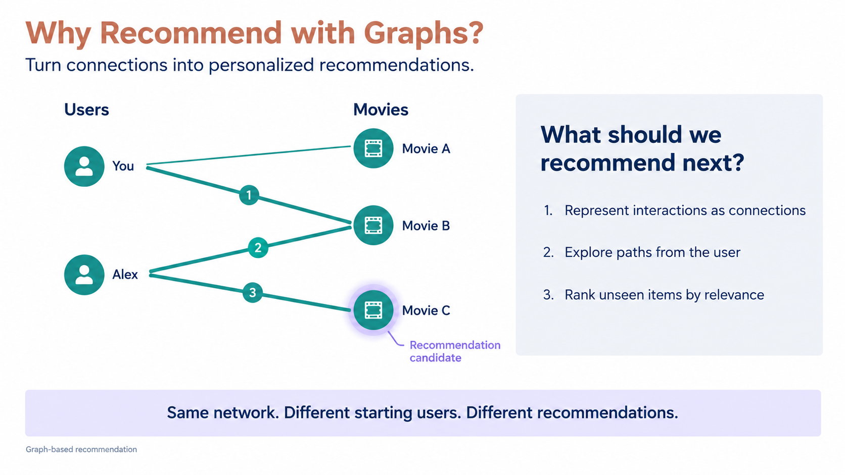

Slide 5
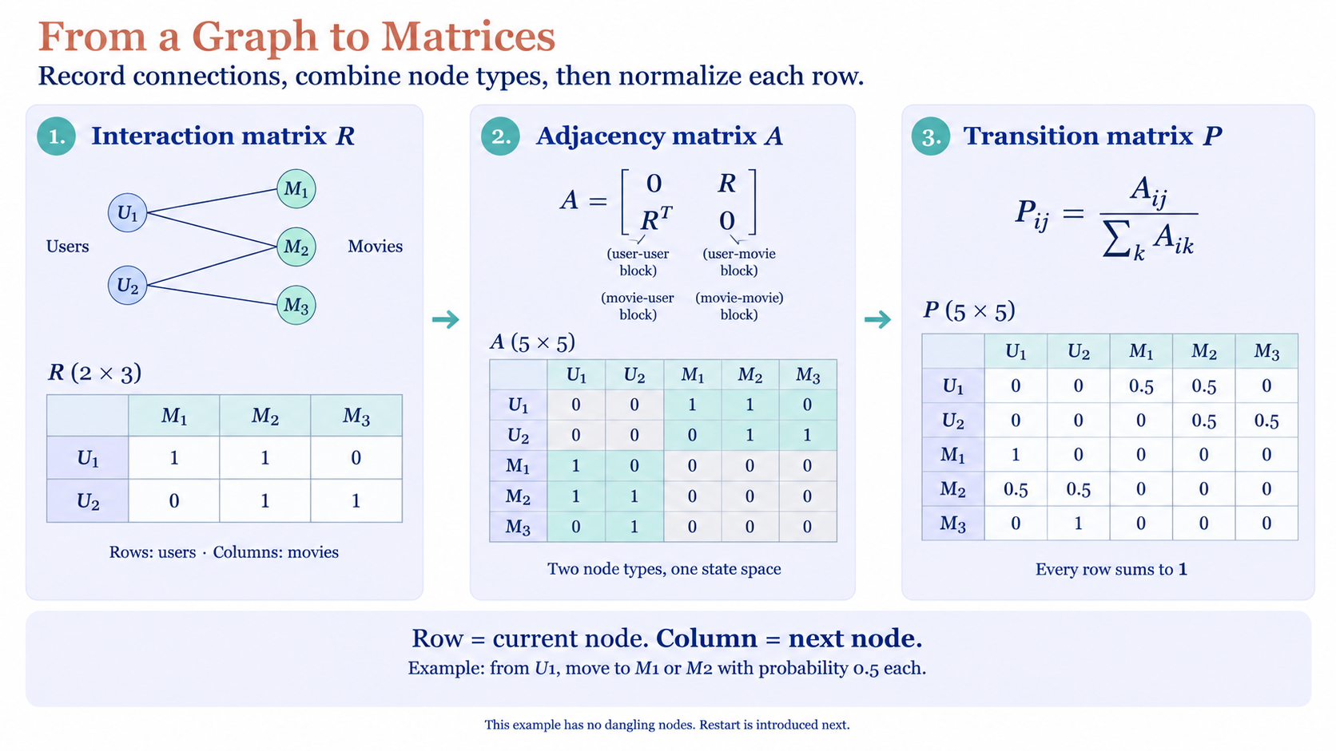

Slide 6
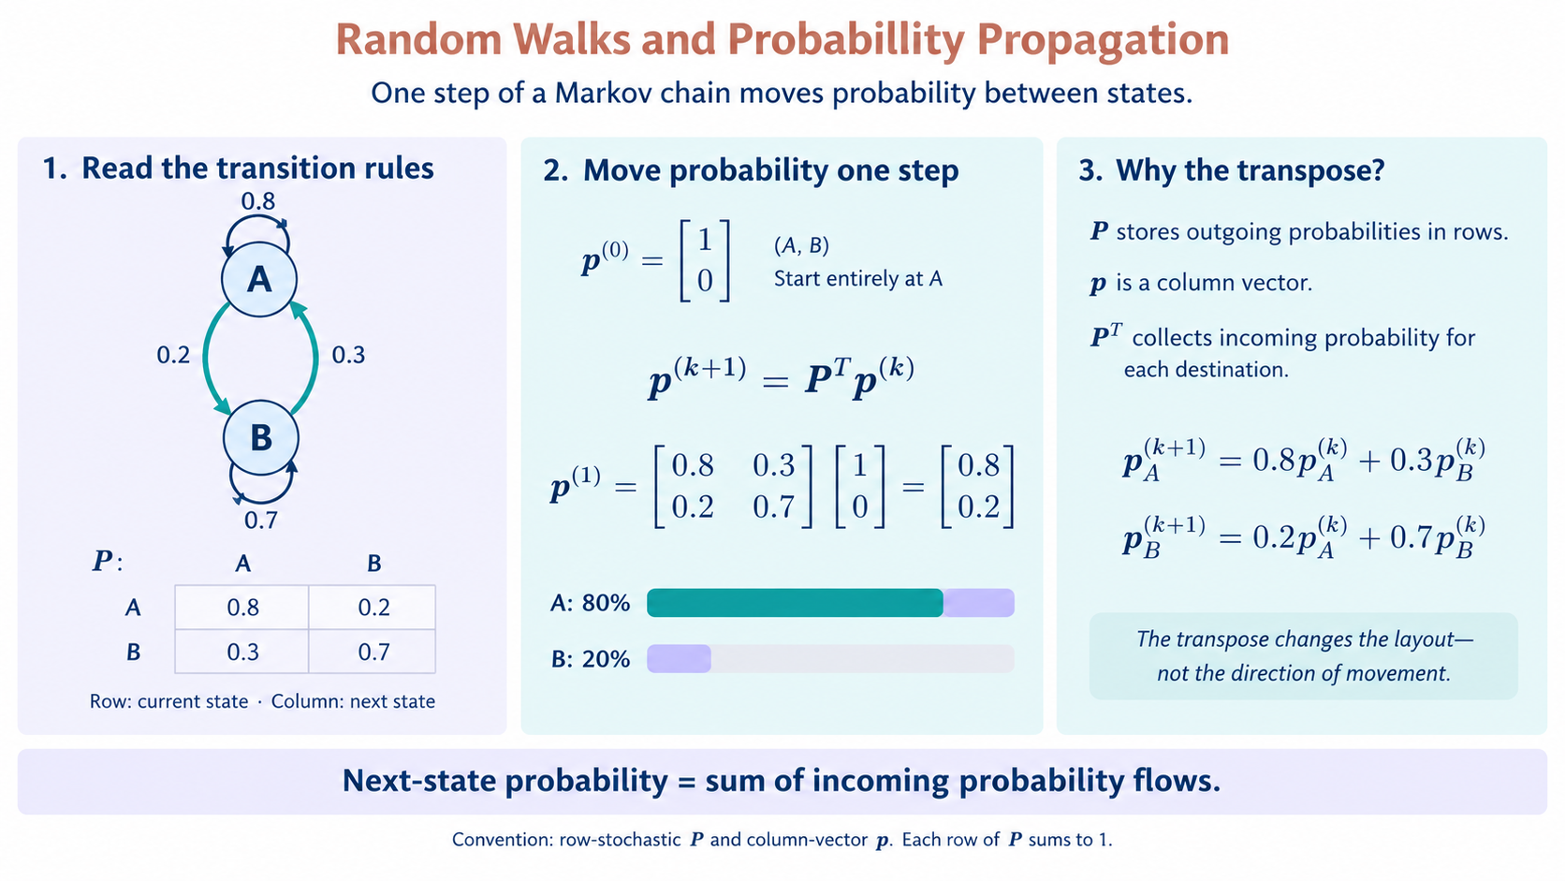

Slide 7
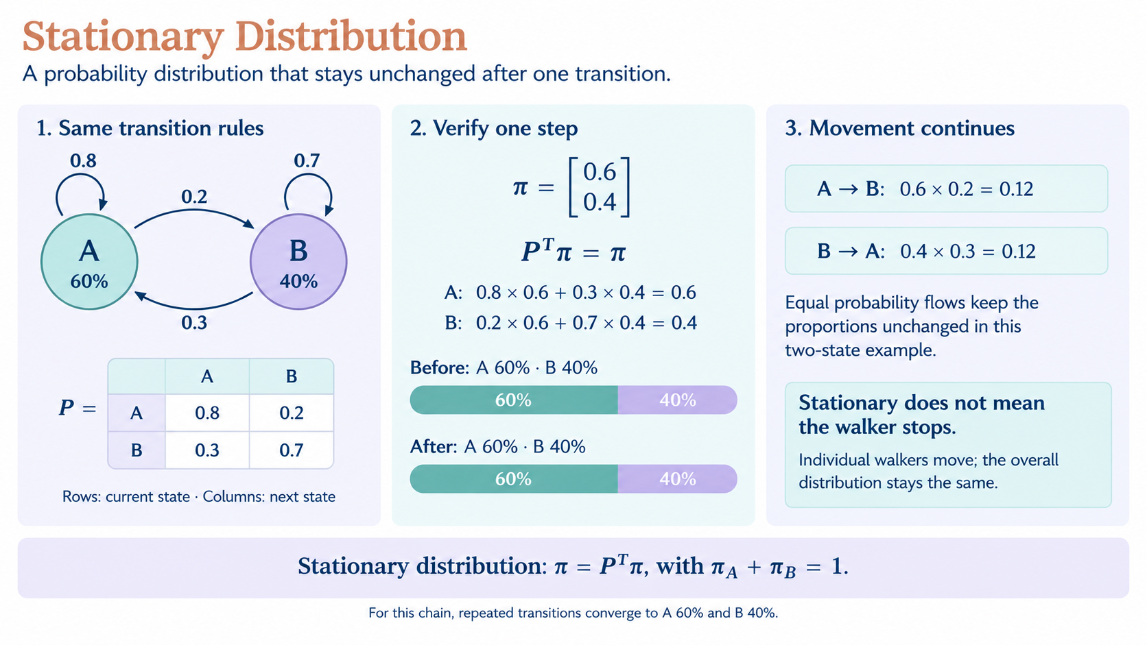

Slide 8
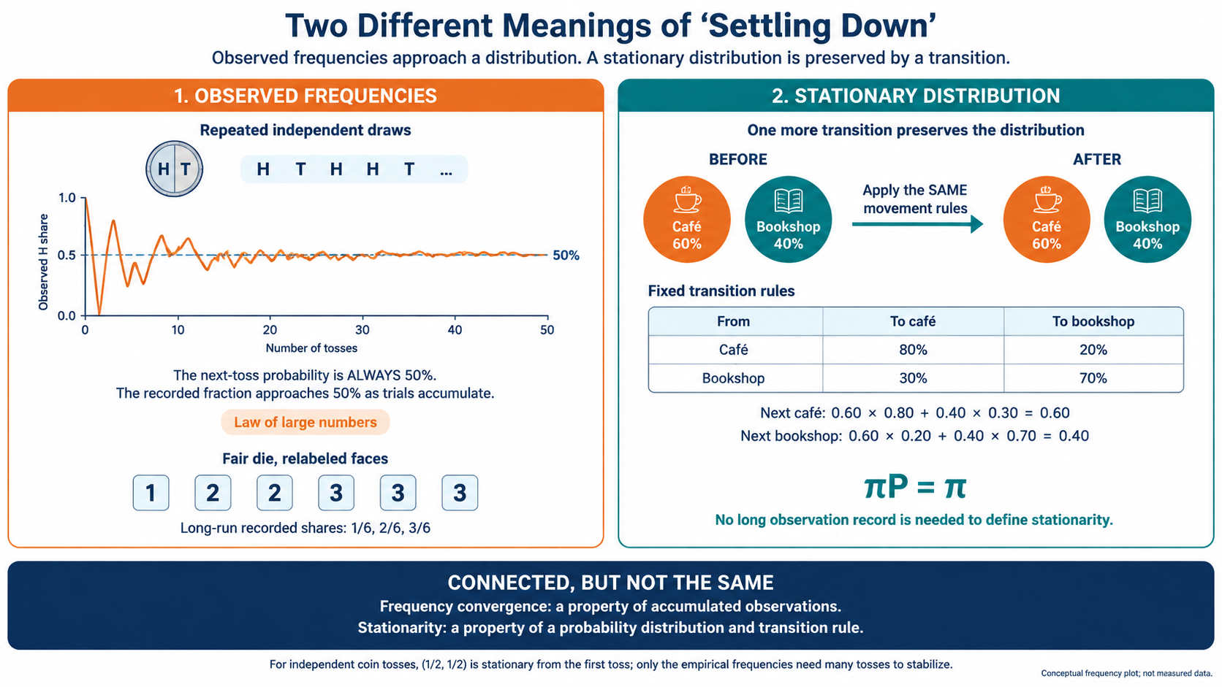

Slide 9
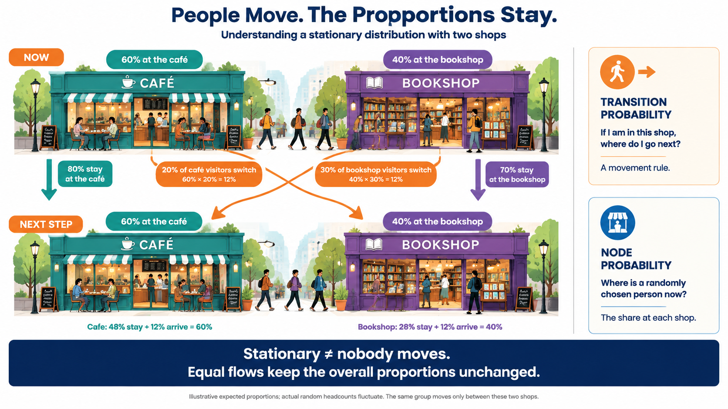

Slide 10
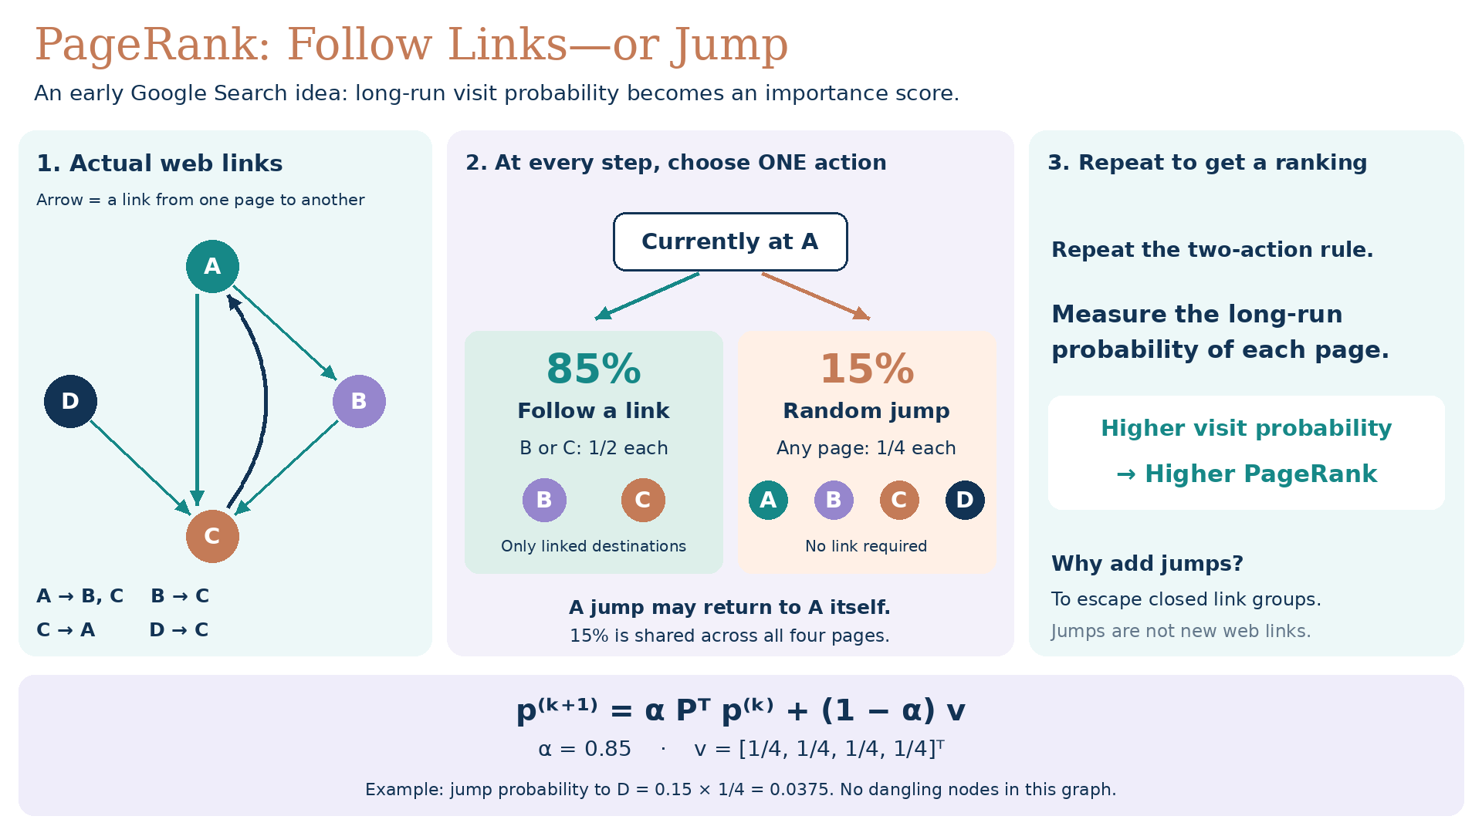

Slide 11
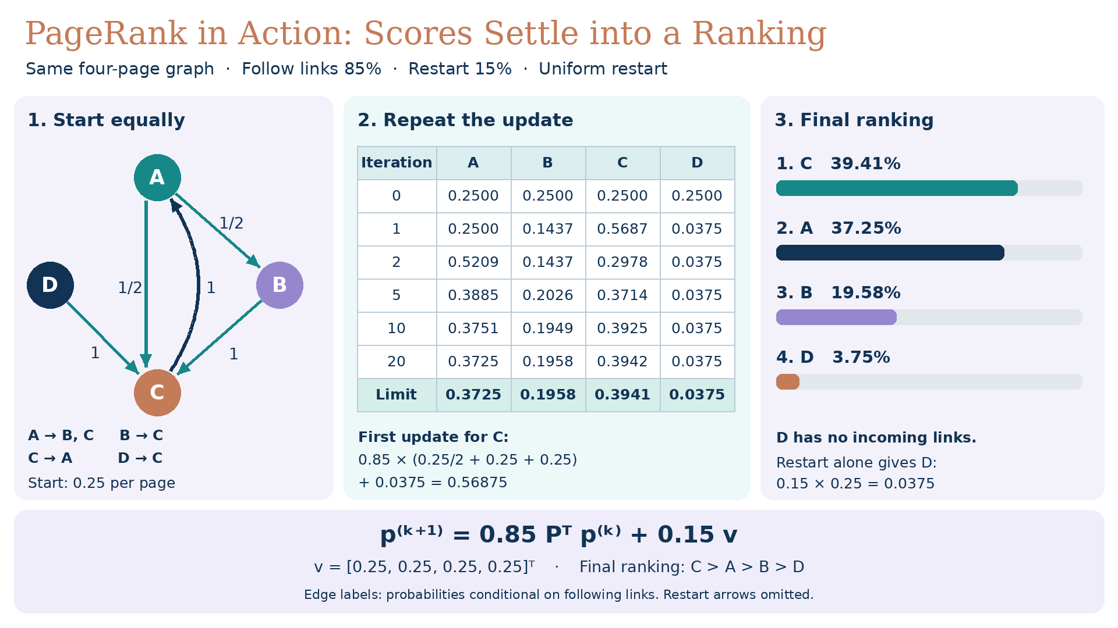

Slide 12
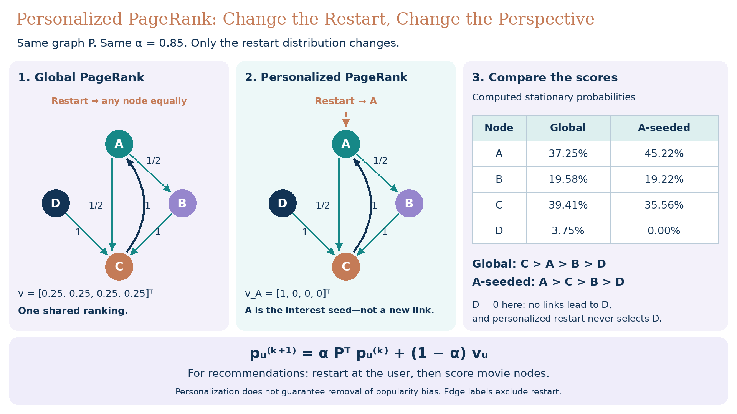

Slide 13
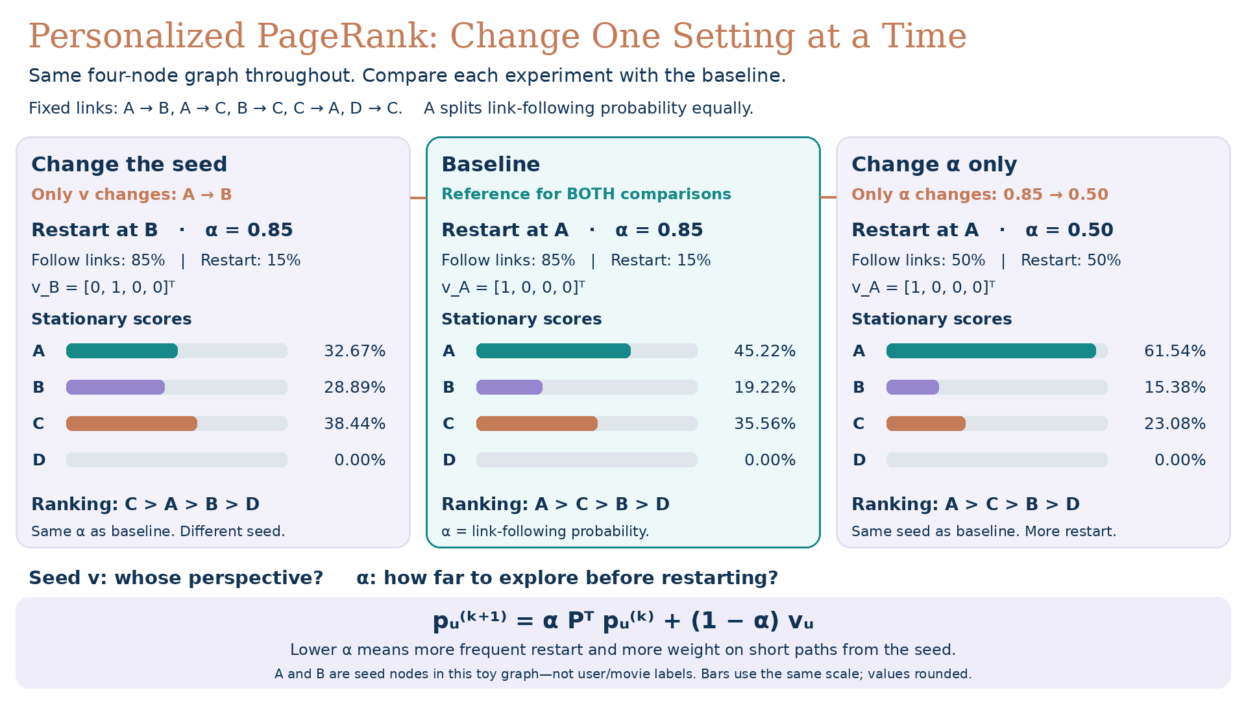

Slide 14
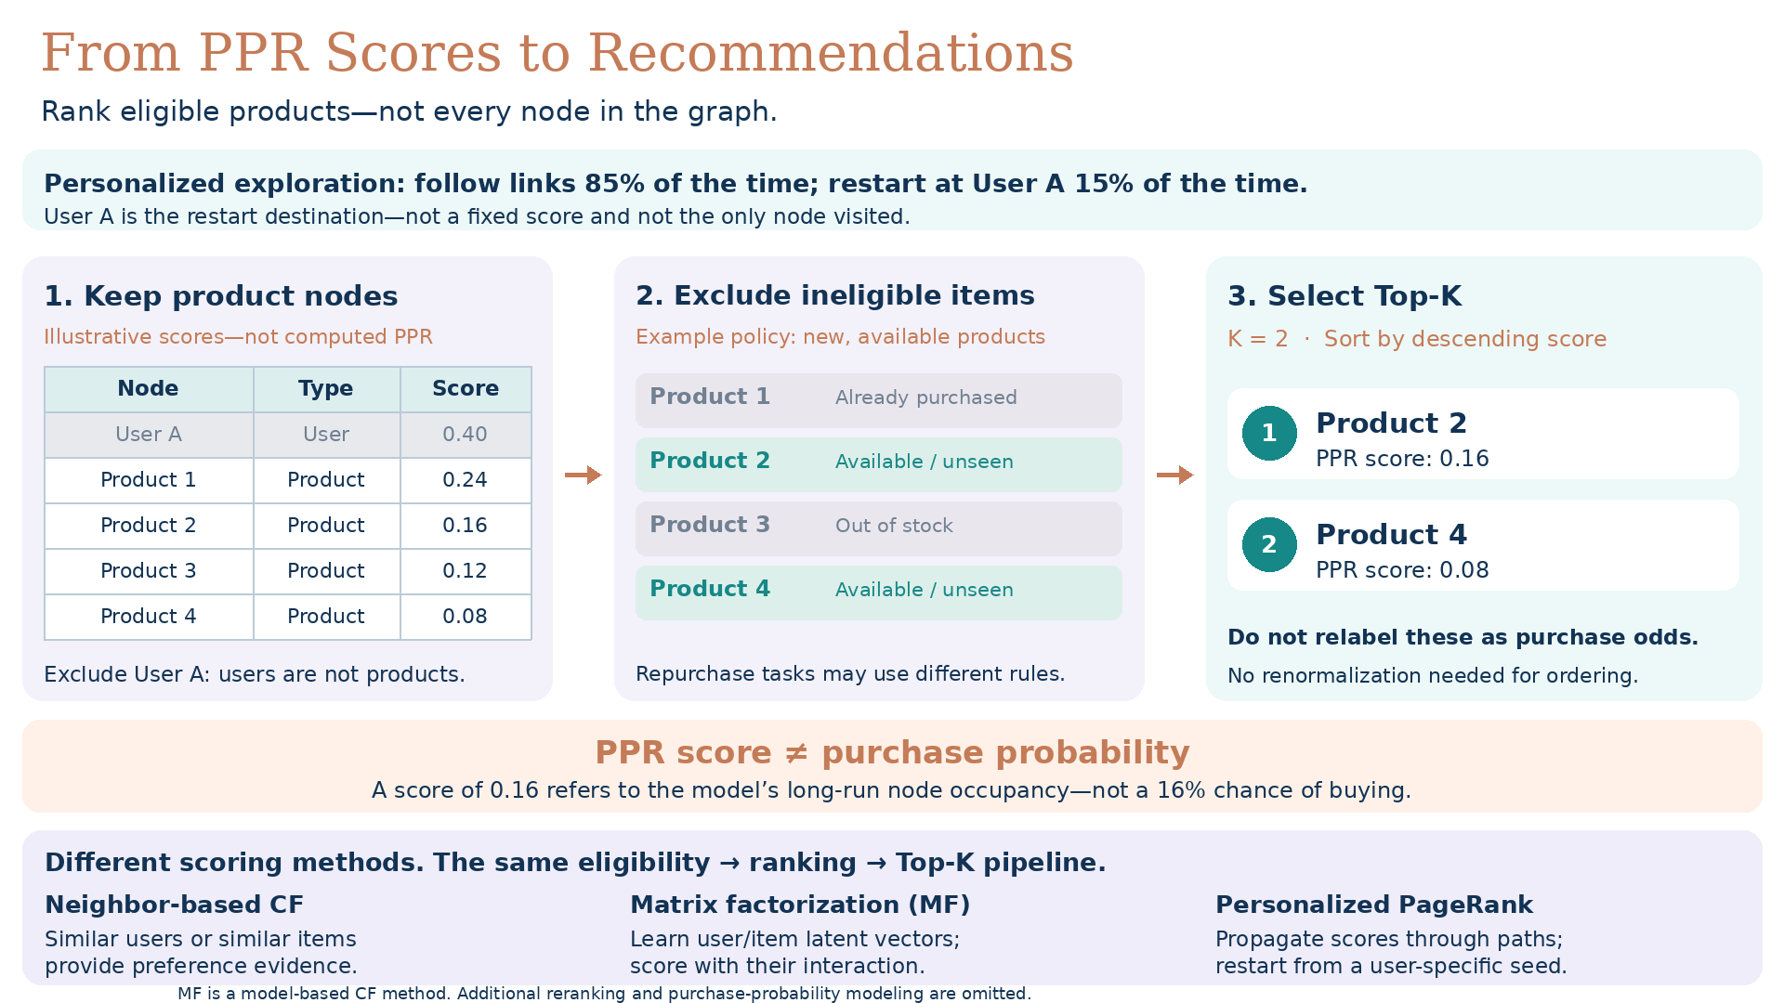

Slide 15
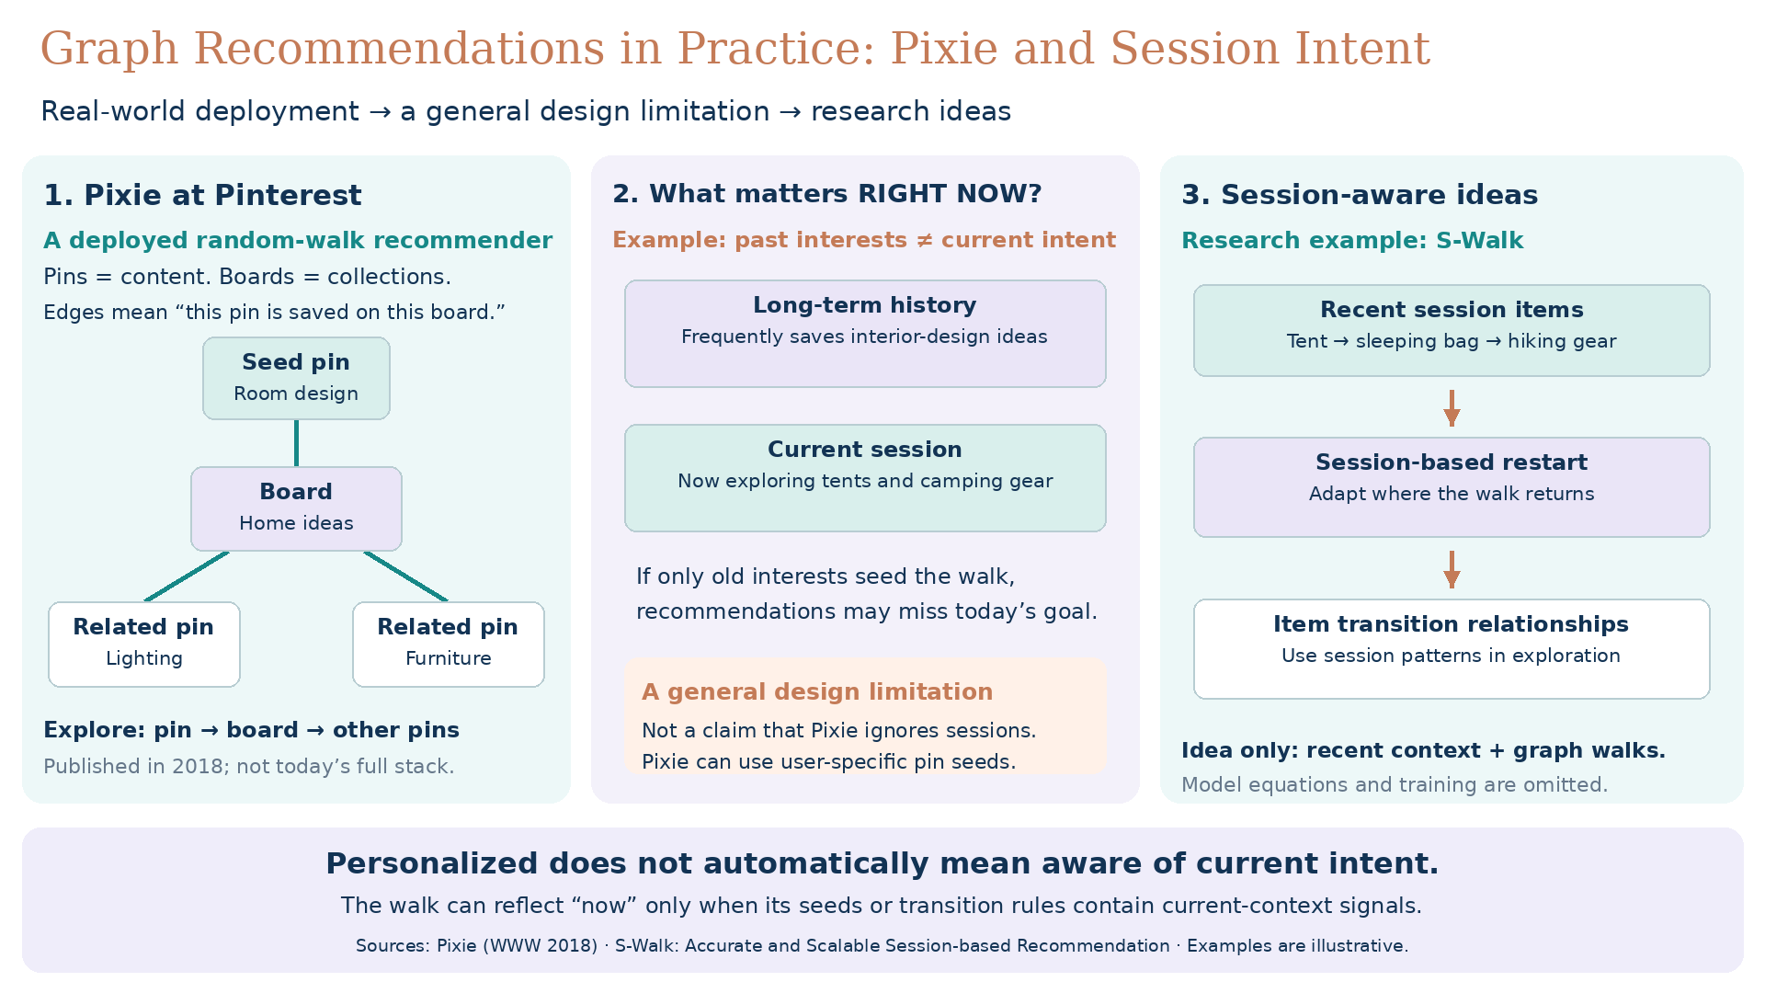
[1711.07601] Pixie: A System for Recommending 3+ Billion Items to 200+ Million Users in Real-Time

Slide 16
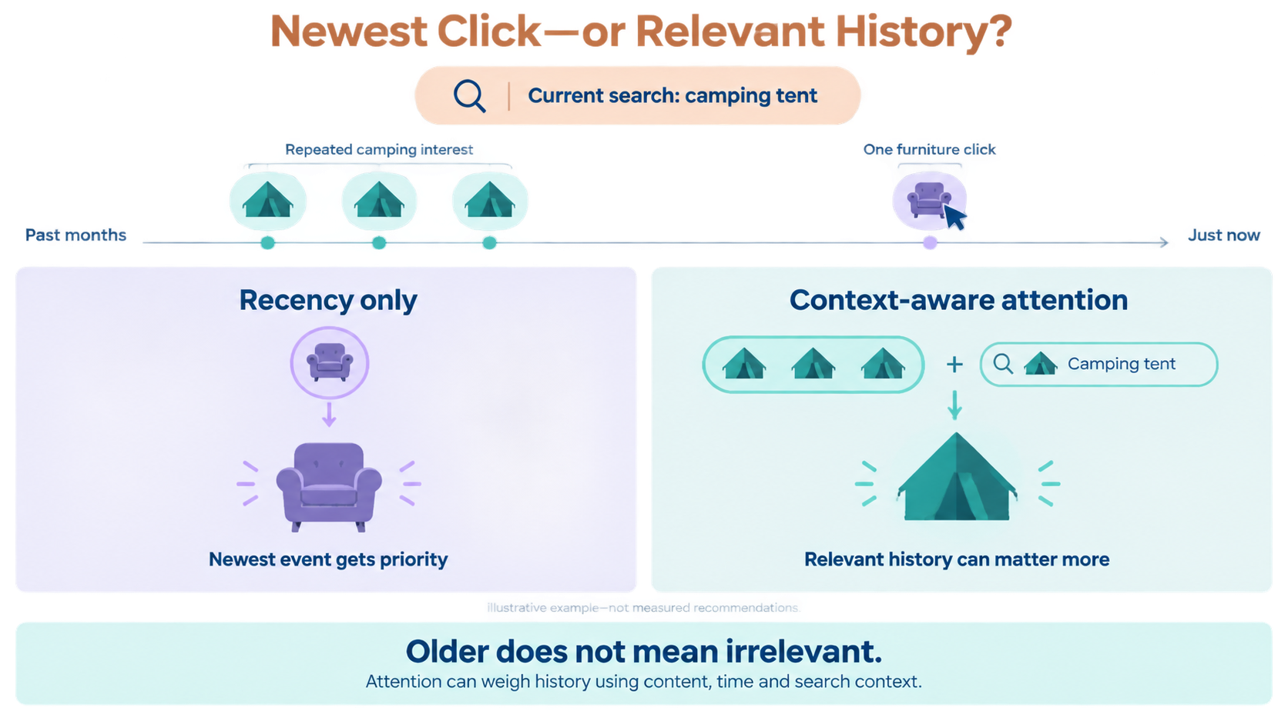

Slide 17
Discussion

Slide 18
HW5. From Ratings to Recommendations
1. Implementation Task
Repository: dryjins/RecSys-LLMs/tree/main/week5
Dataset: MovieLens 100K; use week5/u.data for user–movie ratings and week5/u.item for movie titles and genre indicators.1453
Implementation: Build a JavaScript-based application to train and evaluate matrix factorization.
Data Preparation: Report users, movies, ratings, and matrix sparsity. Treat missing ratings as unobserved, not zeros.
Data Split: Sort each user’s ratings by timestamp; use 80% for training, 10% for validation, and 10% for testing. Report exclusions of users or movies absent from training.
Baseline: Predict ratings using the training-set mean.
Matrix Factorization: Learn 16-dimensional user and movie vectors; predict ratings using their dot product.
Training: Minimize squared error on observed training ratings. Select the checkpoint using validation RMSE; report baseline and MF test RMSE.
Recommendations: Produce Top-10 lists for two test users, showing movie titles and scores. Exclude movies rated in training or validation.
Evaluation: Treat test ratings ≥ 4.0 as relevant. Report average Recall@10 over users with eligible relevant test movies, using all training-set movies as candidates.
2. Business & Algorithmic Analysis
Familiar Choices vs. New Discoveries: Do your recommendations help users discover movies, or mainly repeat their existing preferences? Compare two users’ Top-10 lists with their past ratings. Use specific movies or genres to discuss familiar choices, new discoveries, and their value for a streaming platform.
https://dryjins.github.io/RecSys-LLMs/week5/

Slide 19
HW6. Personalized PageRank Movie Recommendations
1. Implementation Task
Repository: dryjins/RecSys-LLMs/tree/main/week6
Dataset: Reuse MovieLens 100K (week5/u.data and week5/u.item) and the previous per-user chronological 80%/10%/10% split.
Graph: Build a user–movie graph from training ratings ≥ 4.0. Treat missing ratings as unobserved.
Implementation: Compute global PageRank and user-seeded PPR with TensorFlow.js. Define α\alphaα as the link-following probability.
Verification: Check transition normalization, probability conservation, convergence, and zero-degree-node handling.
Evaluation: Select PPR’s α\alphaα using validation Recall@10. Compare popularity, global PageRank, PPR, and your previous MF on the same eligible test users and candidate movies.
Filtering: For validation, exclude movies rated in training. For testing, exclude movies rated in training or validation.
Recommendations: Produce test Top-10 lists for the same two users, showing movie titles, genres, and scores.
Controlled Comparison: Separately change one setting at a time—user A/B at α=0.85\alpha=0.85α=0.85, then user A at α=0.85\alpha=0.85α=0.85 versus 0.500.500.50. Use the validation-selected α\alphaα for the final PPR evaluation.
Reporting: Report test Recall@10, evaluation exclusions, and recommendation popularity based on positive training ratings. PPR scores are not predicted ratings or purchase probabilities.
2. Business & Algorithmic Analysis
Should the streaming platform keep MF, replace it with PPR, or use the two methods in different recommendation sections? Choose one strategy and justify it using your Recall@10 results and specific movie examples from the same two users’ Top-10 lists.

